Slide 2
Where to Start?
Launching or adding a DTG line of business
Thursday, November 5th, 2015 3:00pm to 4:30pm
Presented by:
Karl Tipre - AnaJet LLC
& Special Guests - PoPATL

Slide 3
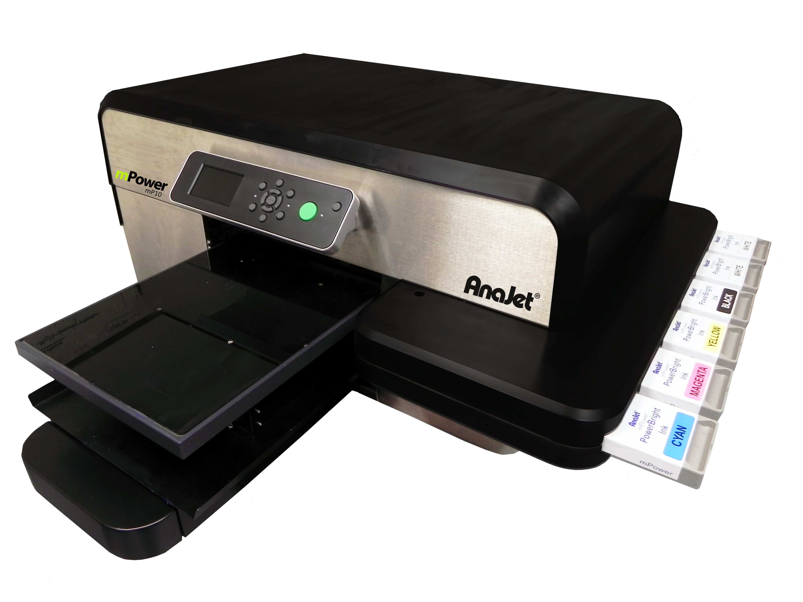
THE AGENDA
Introductions
Karl Tipre
PoPATL
Ryan Gosling / Macaulay Culkin T-Shirt Battle
General Principles
Startups
Existing Businesses
Pitfalls to Avoid
Q & A Session
Notes:
This is not an AnaJet sales pitch. We want this to add value for any garment decoration business. If you have specific DTG or AnaJet questions, we will both be free after the main content.

Slide 4
About Your Presenter
KARL TIPRE has been with AnaJet for more than 6 years as the National Sales Manager. Karl is responsible for all direct sales and enterprise sales in the United States. Karl went to school for business management and is an expert in the sales and service industry with prior experiences serving as President of FC Liberty, a financial services firm, VP of Sales at Iceman Rx, and as an Area Manager of Ameriquest Mortgage Company..

Slide 5
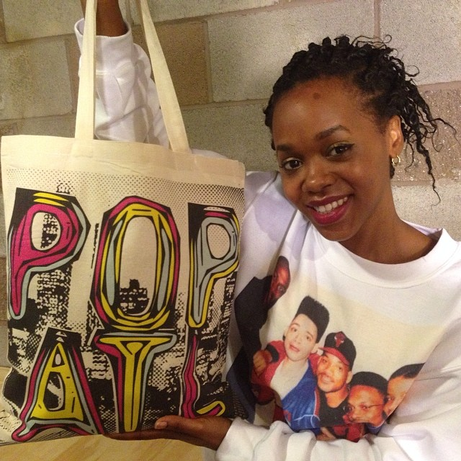
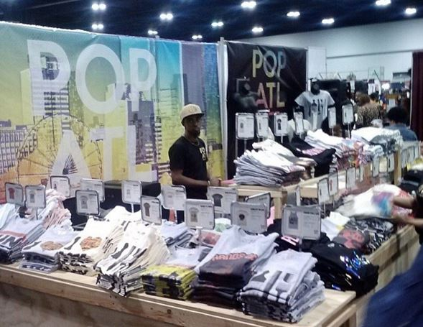
PoPATL
PoP (Prints of Peace) ATL was started by Brian Wynder and Charlie Bunkley back in 2012.
They began as silk screeners, but eventually, they decided that getting a DTG printer was their next step to growing their business.
After purchasing their mPower in September 2013, they shortly achieved their ROI in less than 90 days. Since then they have added more mPowers to their business, as well as sublimation and embroidery to cover all aspects of the garment decorating industry.
Not only do they sell their own designs on their website, they also accommodate custom orders and large wholesale orders with their DTG printers.
Within the last year, they have relocated 3 times to accommodate their need for production space

Slide 6
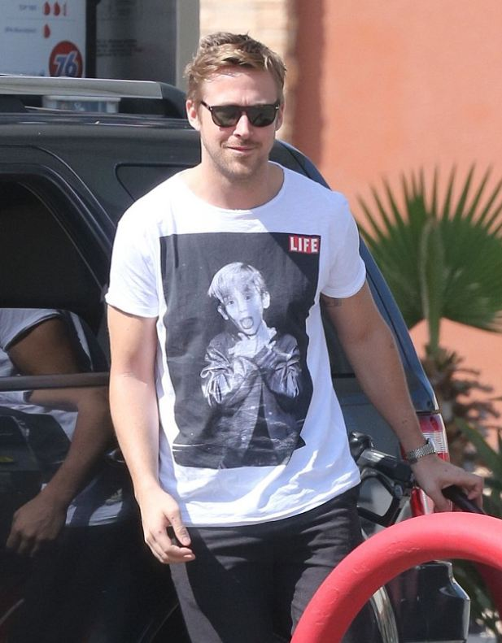
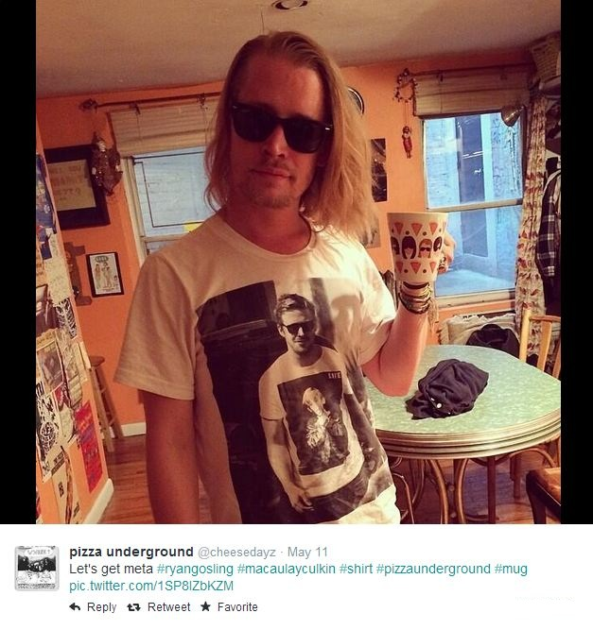
Ryan Gosling / Macaulay Culkin T-Shirt Battle
Ryan Gosling was spotted in March 2013 wearing a shirt printed with a photo of Macaulay Culkin from his 1991 LIFE Magazine profile.
Then, on May 11, 2014, Pizza Underground posted a photo of Macaulay Culkin wearing a t-shirt printed of that same photo.
Guess who printed that shirt for Macaulay? None other than PoPATL!

Slide 7
General Business Principles
Marketing
Plan and budget
Product mastery and maintenance
Graphic design
User friendly software, or contract help
Supply chain
Quick access to blanks and inventory consumables
Operational efficiency
Order processing, accounting software

Slide 8
Why DTG?
Low barrier to entry: becoming more accessible at all levels
Established technology with mature product lines: ~ten years since first DTG printers launched (cf. to iPhone, 2007)
More durable printers: major fulfillment places run them 24x7
High potential for margins: 35% to 75%
Quickly returns investment

Slide 9
AUDIENCE POLL
Who has not yet started?
Who has started within the last 6 months?
Been in business for more than 1 year?
More than 3 years?

Slide 10
Startup Business
Create business and marketing plan
Establish company type
Acquire equipment and decide where to place
Execute plan

Slide 11
CRAFT A QUALITY BUSINESS PLAN
Have a business plan to serve as a guideline
Cost to start up: Do you need graphics/accounting software? What will the equipment costs be? Do you plan to have a website or hired labor?
Marketing costs: What will produced samples cost, will you do print or web advertising?
Product offering and pricing: What type of products will you offer, what demand can you fill and how much will you charge?
Business plans don’t have to be long and complicated
Update and modify your plan as business conditions and goals change and expand
Notes:
Have Katie explain how she crafted her business plan.

Slide 12
Biz plan first steps
Set realistic goals
Decide if you will be part time or full time
Determine capacity- Expectations for output of finished product per hour, per day, per week
Decide on equipment based on expected production and industrial quality
Factor in time for handling, administrative tasks
Above will be part of cost model for profitable pricing

Slide 13
Calculator Examples
Payoff Calculator
Total investment |  | $40,000 | Includes equipment, supplies
Target monthly run rate |  | $10,000
Average job size |  | $450
Number of jobs per month |  | 22.2 | monthly run rate divided by job size
Cost of goods sold (estimated) | 40% | $4,000 | All labor and materials
Overhead (estimated) | 15% | $1,500 | Space, utilities, insurance, advertising, taxes
Monthly net income |  | $4,500
Time to achieve payoff at full run rate |  | 11.1 | months
Jump start sampling calculation
Number of jobs per month |  | 22.2 | from Payoff Calculator
Your typical conversion rate |  | 20% | Estimate this; correct as you move forward; targeting will make you more efficient
Number of leads needed per month |  | 111 | You need this many leads or referrals to get N jobs; assuming no repeat business
Number of leads per week |  | 25 | Typical month is 4.4 weeks
Number of sample drops per day |  | 5
Cost of each sample |  | $3.50
Initial monthly sampling investment |  | $389 | After 6 months, 132 jobs at $450 each, ~$60,000 gross
Notes:
These are some conservative calculations for someone who is planning to run a very aggressive growth strategy to a $10,000 monthly gross income. It’s a big numbers game sometimes. If you’re starting up you need to see the full scale of what it takes to acquire business, because it will not just come knocking at your door until you have built up a critical mass of clients. This can help do away with any illusion that garment decoration is an easy way to get rich quick.

Slide 14
Make Accounting a Habit
Get QuickBooks or Quicken to track I&E
Generate purchase orders to suppliers from your system
File and scan receipts and invoices
Will save you grief at tax time
Get your business license and reseller certificate!
Look at cost to hire a CPA
IRS audit: self employed are at higher risk
Notes:
i&e = income and expenses

Slide 15
Ramp up Time
Don’t take orders for day one
Allow yourself learning curve, master new technology, new software, new ordering/sourcing processes, etc.
Get samples from a few suppliers
Understand graphics or find someone who does
Buy PhotoShop Elements as a bare minimum, other programs include Illustrator, Corel Draw, Spark

Slide 16
PRICE FOR PROFIT
Know all of your COSTS
Cost of Goods Sold: blanks, supplier shipping, inks, pre-treatment, direct labor
Overhead: Equipment purchase; rent, utils, insurance, taxes, license, gas, administrative tasks like handling and other non-printing labor
Develop a pricing model that aligns with
Your market expectations
Your capacity to work on the business
Your skill level
Pricing structure is supposed to make you money
Be aware of competition – real vs. perceived
Don’t race to the bottom
Notes:
We actually have a couple of archived webinars on our site as well as on ASI learning web site that offer some advice on pricing and margins. We have a presentation on our blog as well that you can download.
Ask Katie to explain how much does she charge her shirts and how did she come to those numbers

Slide 17
DO MARKETING 101
Order business cards and ask a sign maker to create a vinyl car graphic for your back window
Configure your voicemail system to have a pleasant greeting and notify you via e-mail when you miss a call
Craigslist, PrinterListings.com, Ebay, Etsy.com
Create and send out postcards announcing new products and offer special discounts on initial orders – mailing houses can often design and execute for you
Radio ads: cost $$ to produce but can be as cheap as $50 a spot; strong local lead generator
Bennett radio ad

Slide 18
SAMPLE DAILY
Put printed/decorated garments (and business cards) into everyone’s hands
Should be cheap – no more than $3-$4 each on white shirts
Sample for one hour per day, every day in your target neighborhood
As time goes on, you won’t need to sample as often, as you will be too busy filling orders
Notes:
Explain that you can incorporate sampling into your daily maintenance routine.

Slide 19
Example Start-up Plan with No Sales Calls
School – 500 students, 1,000 parents
Place of worship – 200 families
Work – 50-100 coworkers
Email list – 50-100 contacts
Social Media profile – 100 friends

Slide 20
Example Start-up Plan with No Sales Calls
School – 500 students, 1,000 parents
Place of worship – 200 families
Work – 50-100 coworkers
Email list – 50-100 contacts
Social Media profile – 100 friends
900 Families
You already know 900 (or more) potential customers and referrals

Slide 21
Example Start-up Plan with No Sales Calls
School – 500 students, 1,000 parents
Place of worship – 200 families
Work – 50-100 coworkers
Email list – 50-100 contacts
Social Media profile – 100 friends
900 Families
You already know 900 (or more) potential customers and referrals
10% rule: make everyone aware of your business
50 Customers
20 Customers
5 customers
5 customers
10 customers
If average order is 20 pieces, average price of $15 each, 90 x 20 x 15 = $27,000

Slide 22
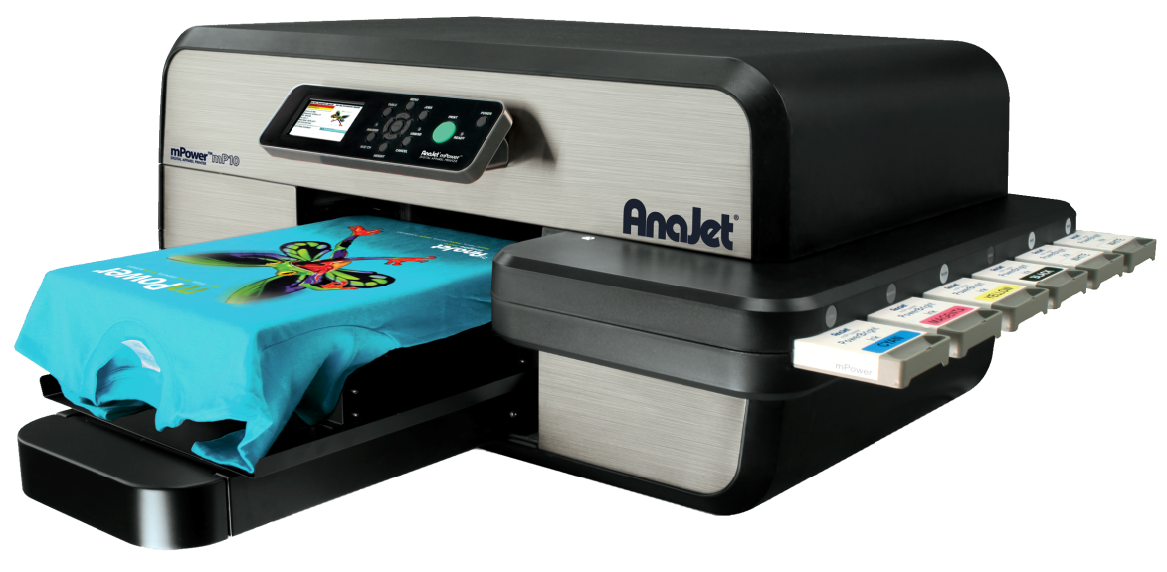
BUY SMART AND MAINTAIN YOUR EQUIPMENT
Invest in quality equipment and software
“You get what you pay for”
Heat press, pre-treatment sprayer, PC, graphics software, hygrometer, non-condensing humidifier
Keep your machines in tip-top shape with regular maintenance
Using good equipment and software will save you time and money in the long run
Notes:
Printer
Press
Sturdy tables for each
pre-treatment sprayer
Adobe suite / Corel

Slide 23
Grocery List
Printer with WARRANTY: if you buy 3rd-party, research cost to get refurbishment & factory warranty
Heat press with auto-lift: clamshell or swing away
Tunnel dryer: advantage in colder climates
Power sprayer or pre-treatment machine
Cool non misting humidifier
Hygrometer
Extra set of inks, cleaning solution, and other consumables
Sturdy tables for printer and press

Slide 24
Graphic and garment suppliers
Design Interface / Graphics Manipulation Client (i.e. SPARK)
Great Dane Graphics –
Action Illustrated
Online photo stock sites
(i.e. Shutterstock.com)
Cotton Heritage
Hanes
Spectra USA
Alstyle
Bella + Canvas
Notes:
Design Interface / Graphics Manipulation Client : i.e. Spark or Inksoft
Photostock: shutterstock. Istockphoto, fotolia, etc

Slide 25
Existing Imaging Businesses
Decide who will “own” the new operation/process
Prepare marketing plan and pricing based on demand
Take advantage of existing customer base, regular accounts
Give them a “One-stop-shop”

Slide 26
Expand Skillsets
Identify new opportunities and seize them
Multi-color runs
No minimum orders or screen charges
Quick turn around with a versatile product line
Mobile on-site printing
Marketing new capabilities
Facebook and other social media
Samples in all existing customer orders
New website content or customer facing design software

Slide 27
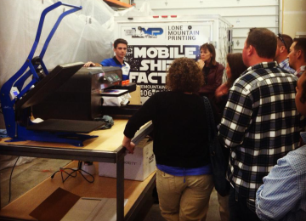
Dedicated Shop Space
DTG printers and presses take up minimal footprint…
But MUST HAVE dedicated space large enough so that printer and press are at least 5-6 feet apart
Must be able to maintain a humidity level above 45% near printer
Avoid close exposure to HVAC, doors, dust, excess moisture
Carve out space for treating and drying your pre-treated shirts and other dark garments

Slide 28
Optimize Inventory
You’re going to be buying a lot of shirts
Use suppliers’ warehouses as your own
Keep sample stock only and push suppliers for same-day shipment
Most will do free shipping or free overnight on orders over $200: some as low as $150
Use RMAs for overstock – don’t carry cases of unused blanks

Slide 29
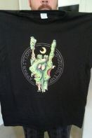
Get to Know Your Competitors
In addition to outsourcing…
Look for garment decorators nearby: they may have DTG printers or parallel technology
Build partnerships: visit decorators in your area to drop off your business card and samples
Working as partners, you’ll be able to plug gaps in each other’s offerings, becoming more of a one-stop solution for customers and increasing sales for everyone

Slide 30
Creative revenue generation
Go back to your entire account list with individual white t-shirt samples
Offer a referral program by turning your customers into your sales team
Discounts on future orders
Free labor services such as design work
$20 Amazon.com gift certificates

Slide 31
IMPROVE WEB PRESENCE
Get photos of your printer and examples of prints up!
Spend 15-30 minutes a day adding
Relevant videos and photos of your work
Posts to Website, Facebook, Instagram, and other social media
New keywords: custom tshirts, full color shirts, no minimums, on demand t-shirts
Plan public exhibits where you print on demand; people love to watch the printer work and then wear their new shirt immediately
Look at these sites:
www.soulproject.com
www.easternshoresigns.com
Recent testimonials posted to YouTube/AnaJetInc

Slide 32
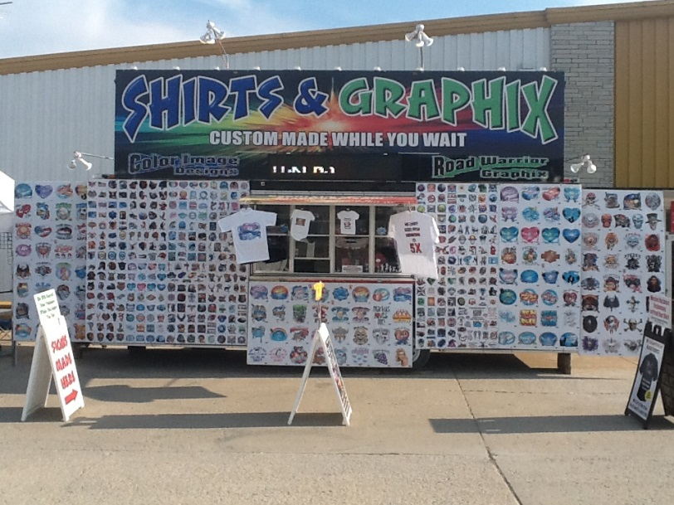
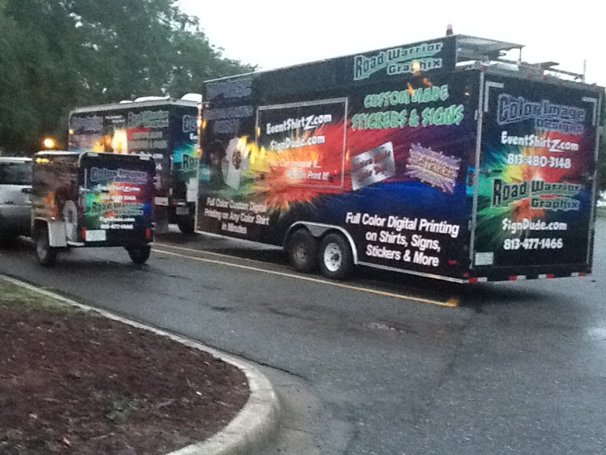
GO MOBILE
Take your printer on the road…. seriously
Offer on-the-spot decoration at local events like county fairs, charity fundraisers, car shows, 5k and 10k runs, etc.
Notes:
.

Slide 33
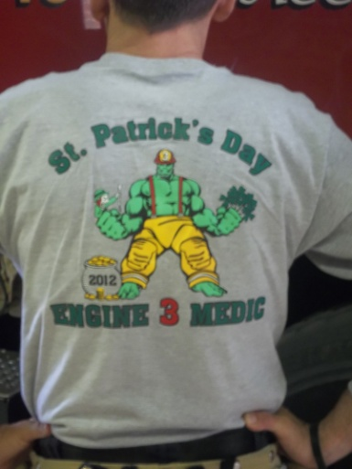
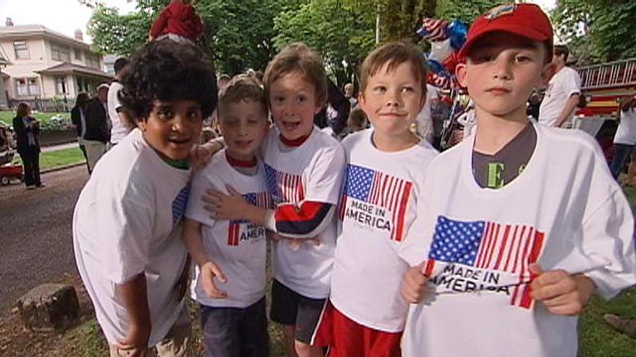
Some Event Types
Car shows
Dog shows
County & state fairs
School “festival” fundraisers
Little league/softball/ soccer
Boy Scouts
Boys & Girls Clubs
YMCAs
5k/10k runs
Fraternity/sorority events
Back to school nights
Community events
4th of July, Labor Day park gathering
Street fairs
Seasonal bazaars
Art walks

Slide 34
Common Mistakes to Avoid
Postpone training – just read the manual and wait until it fails
Most common root cause of all types of “printer” issues
You are the first line of defense for your equipment
AnaJet University is FREE – in-person or online, repeat as often as you like
Outside AnaJet, study graphic design

Slide 35
Common Mistake #2
Make excuses for not performing maintenance
Print head is the HEART of your printer and the most expensive item to replace
Would you buy a new car and let the oil run out?
This is why print heads are not warrantied past 90 days
Hygrometer, non-misting humidifier cost less than $75 – about the price of an oil change
When NOT printing, maintain 45% RH or better and physically look at your maintenance station when docked

Slide 36
Common Mistake #3
Wait for the phone to ring – and several other corollary assumptions
Expect your friends and family to market for you
Don’t tell any of your customer base about your new product line – assume it will grow itself
Don’t use social media to showcase your products and capabilities

Slide 37
Common Mistake #4
Wait until you run into a problem to network with other garment decorators, other DTG owners
Network: the safety NET to help you WORK
Screen printers, embroiderers are “co-opetition”
Find people you trust to outsource to without stealing your business

Slide 38
Common Mistake #5
Compete with the lowest common denominator and price according to THEM
No one else can do what you can do!
NO MINIMUMS
FULL-COLOR GRAPHICS with no screen fees
ON DEMAND, while u wait

Slide 39
HELP ME CHOOSE WHICH TECHNIQUE
It depends on your deadline, your budget and your desired look and feel. These are guidelines, not requirements. We will make sure your order fits your budget and time frame.
Screen printing
Large runs, 50+
Lead times OK, possibly 7 days
1-4 colors
Spot colors
Cotton or poly
Screen fees are OK, you’re trying to reduce costs below $10/pc
Results: high raised feeling of graphics, solid layer of ink
Digital direct to garment
Required for short runs, 25 or less
Need on demand – possibly ready same day
Full digital color, photos, multiple logos or elements
100% cotton or 80/20 blend best
No screen fees, expect to pay more than $10/pc
Results: light or nonexistent hand, breathable

Slide 40
Concluding Thoughts
Train
Practice
Network
Track everything
Sample aggressively, daily, everyone you know has something they want on a shirt
3 legs of the stool: marketing, graphic software, disciplined maintenance

Slide 41
Questions & Answers
Visit www.anajet.com/blog for more advice, tips and testimonials from DTG owners
See us running continuous live demos at booth #2855
No one runs their printers as hard as we do!!

Slide 42
THANK YOU
IT HAS BEEN A PLEASURE!

